Slide 1


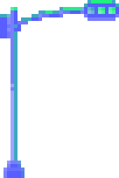



LANDING PAGE OF TBATE
overview and explanation
BY VARSHINI A

Slide 2
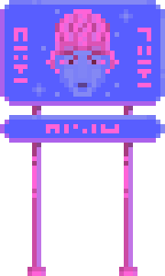
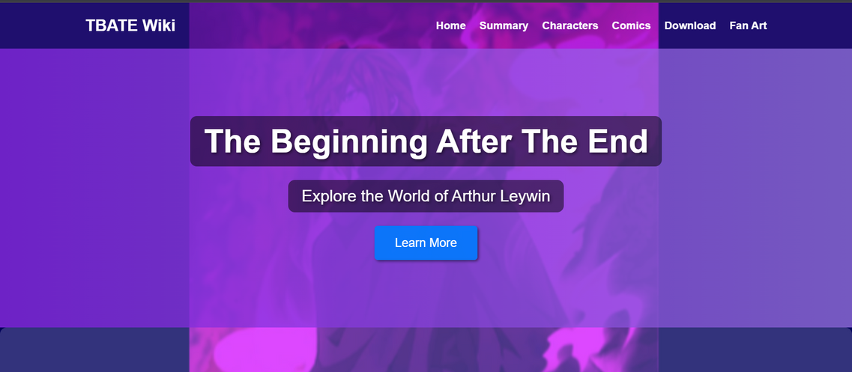

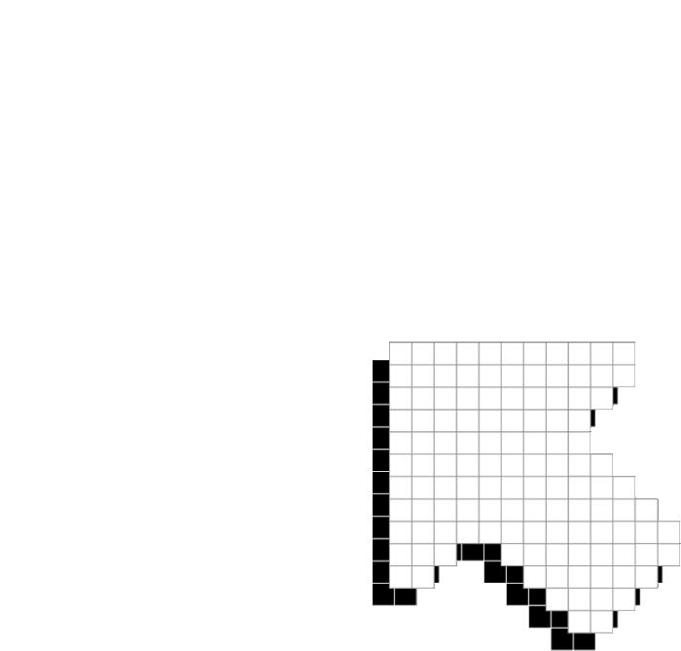

INTRODUCTION
purpose of the tbate landing page
KEY features - summary,
characters, comincs, download
links, fan art.

Slide 3
HTML STRUCTURE
The HTML file is structured into key sections to organize the content effectively. It includes:
  Header: Contains the logo and navigation links.
  Hero Section: Features a title and a call-to-action button.
  Summary Section: Provides an overview of the story.
  Characters Section: Displays the main characters with images and descriptions.
  Comics Section: Includes a link to the comic adaptation.
  Download Section: Provides a link to download the ePub version.
  Fan Art Section: Showcases fan art images.
  Footer: Contains copyright information.

Slide 4
CSS STYLING
The CSS file defines the styles for layout and design. Key CSS rules include:
  Flexbox: Used for alignment and spacing in various sections.
  Background Images and Colors: Enhance the visual appeal.
  Button Styling: Makes the call-to-action buttons stand out.
  Responsive Design: Ensures the page looks good on different screen sizes.

Slide 5
ENHANCEMENTS AND AESTHETICS
To enhance the aesthetics of the landing page, several visual improvements were made:
  Background Image: A subtle background image adds depth to the page.
  Gradient Overlay: Applied to the hero section for a modern and dynamic look.
  Button Hover Effects: Provide visual feedback when users interact with buttons.
  Typography: Consistent font styles and sizes improve readability and visual consistency.

Slide 6
INTERACTIVE ELEMENTS
Interactive elements improve user experience:
  New Tab Links: External links open in new tabs for convenience.
  Hover Effects: Buttons and links change color on hover to indicate interactivity.
  Responsive Navigation: Navigation links adjust based on screen size.

Slide 7
CHARACTER SECTION
The character section is designed to showcase the main characters:
  Character Cards: Each character is displayed in a card format with an image, name, and description.
  Flexbox Layout: Ensures characters are well-aligned and spaced evenly.
  Image Styling: Rounded corners and shadows add a polished look to character images.

Slide 8
FAN ART GALLERY
The fan art gallery section showcases fan creations:
  Center Alignment: Images are center-aligned for a balanced layout.
  Flexbox Gallery: Flexbox is used to create a responsive and visually appealing gallery.
  Image Spacing: Adequate spacing between images ensures a clean look.

Slide 9
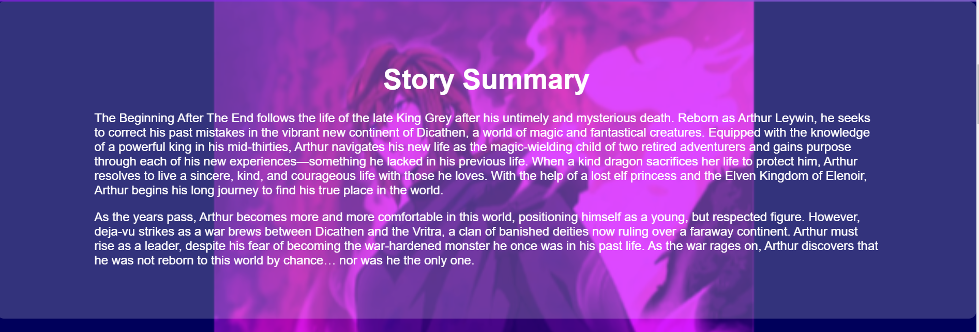

Slide 10
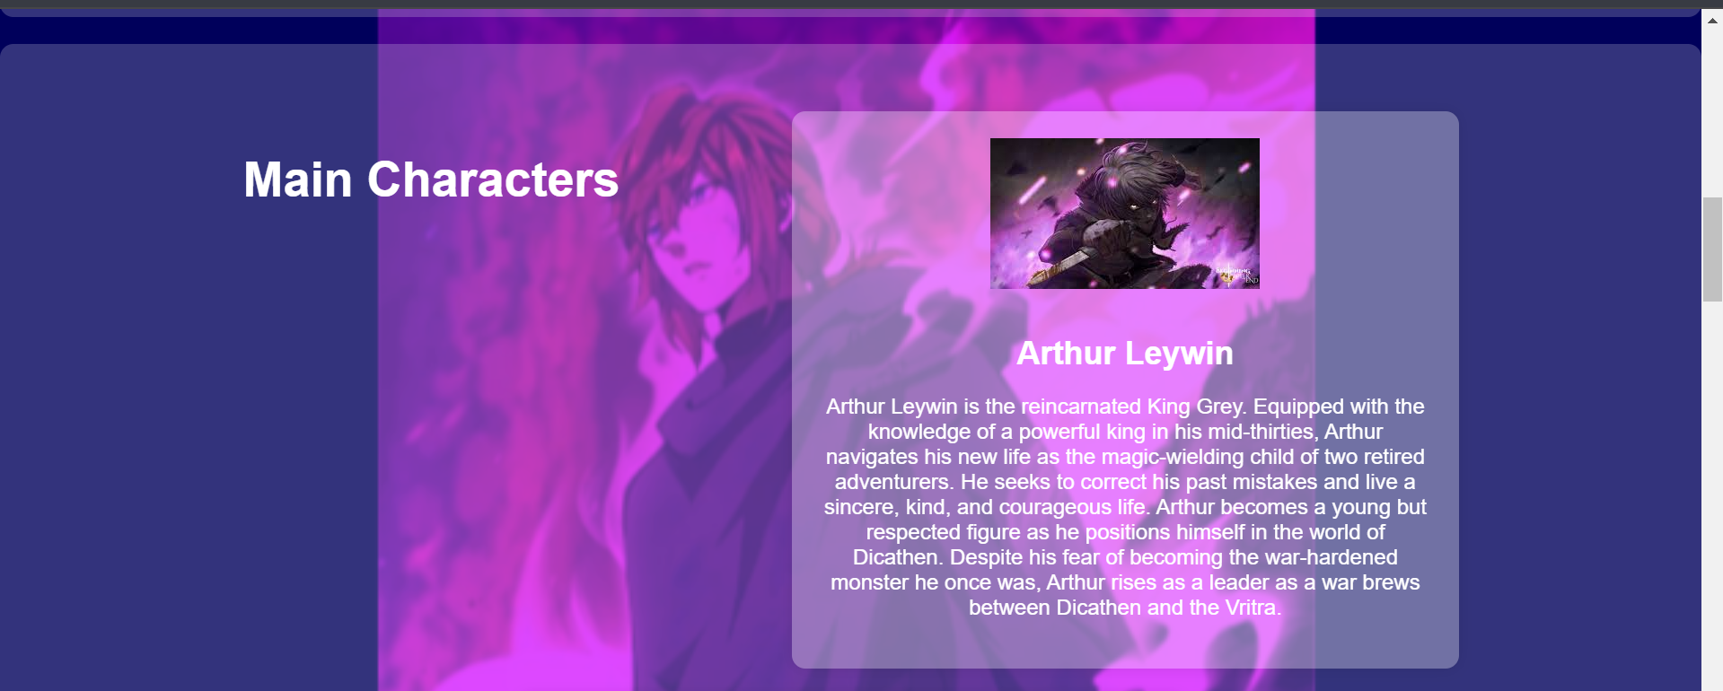

Slide 11
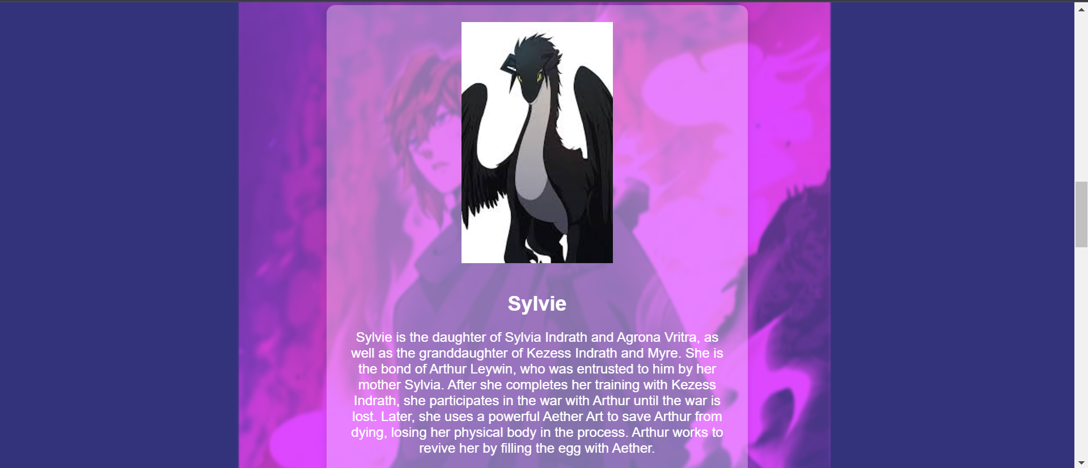

Slide 12
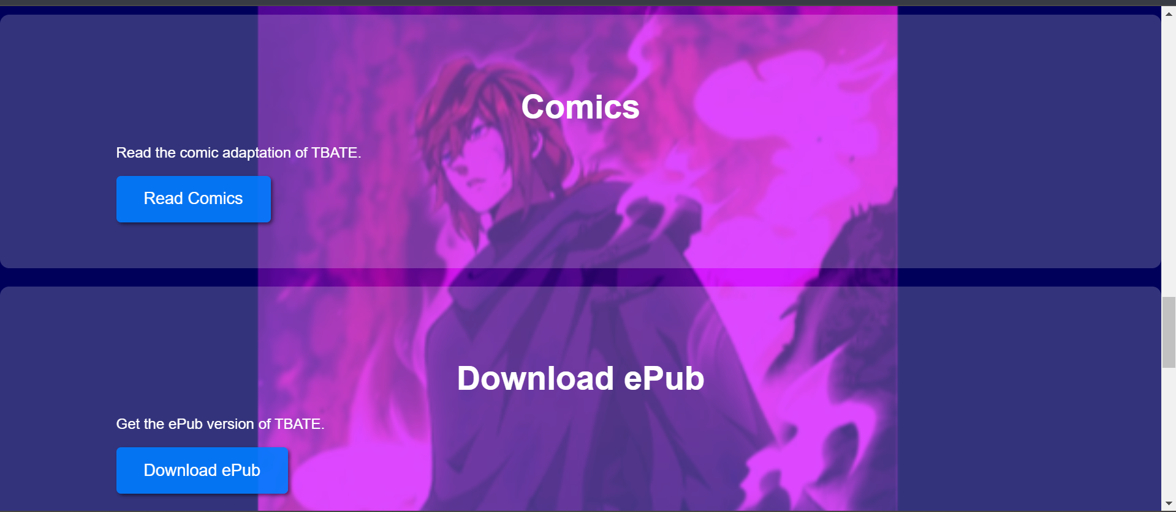

Slide 13
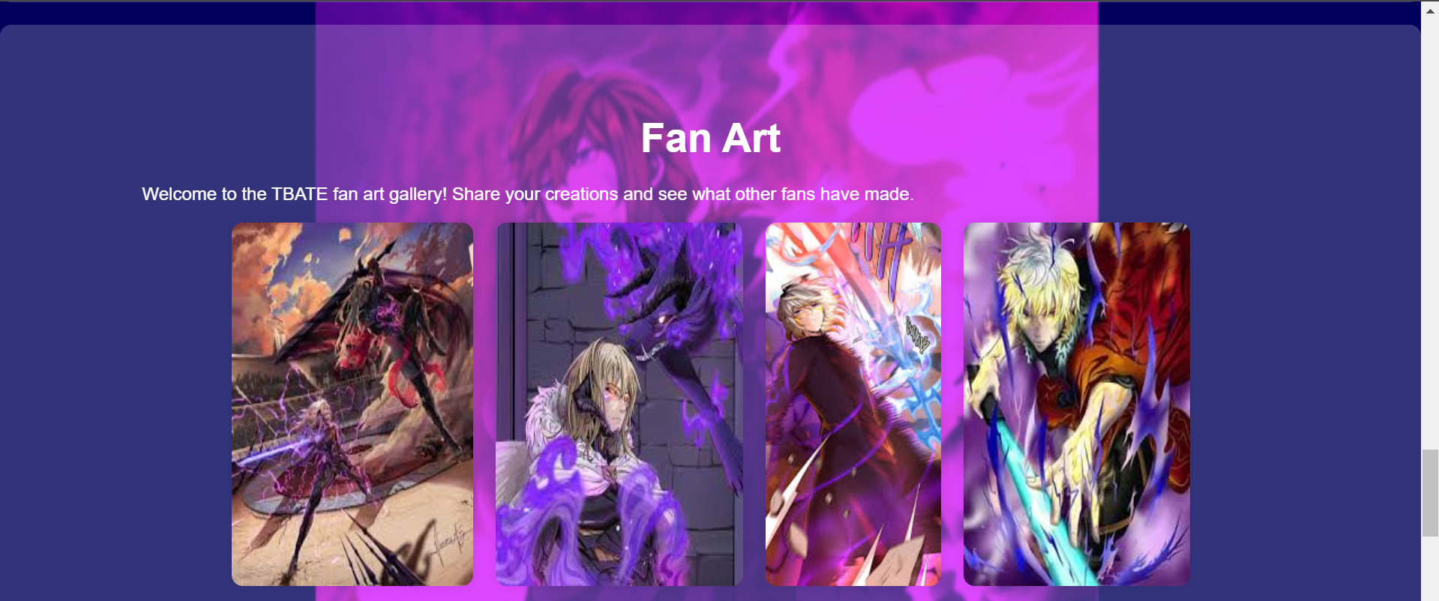

Slide 14


Slide 15
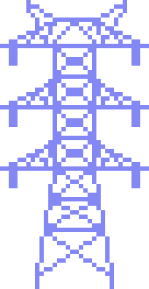

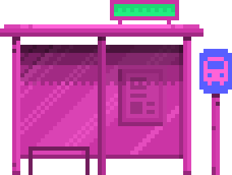



CONCLUSION
IN CONCLUSION, THE TBATE LANDING PAGE EFFECTIVELY SHOWCASES THE STORY AND ITS CHARACTERS WHILE PROVIDING INTERACTIVE ELEMENTS AND AESTHETIC ENHANCEMENTS TO ENGAGE USERS. THE USE OF HTML, CSS, AND RESPONSIVE DESIGN PRINCIPLES ENSURES A SMOOTH USER EXPERIENCE ACROSS DEVICES.

